Slide 1

Vue

Slide 2
Course Layout
- lecture 1 :Introduction to the Course
- lecture 2 :Data Binding
- lecture 3 :Directives
- lecture 4 :Project
- lecture 5 :Routes
- lecture 6 :Forms
- lecture 7 :Project
- lecture 8 :HttpClint
- lecture 9 :Animations
- lecture 10:Linting Testing Deploying

Slide 3
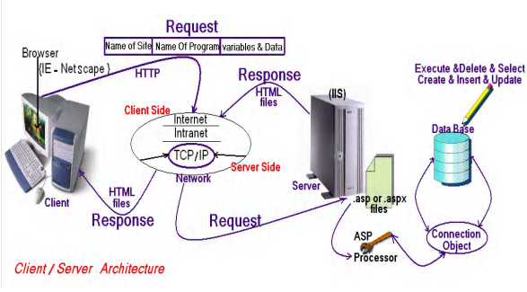
Client/Server Architecture

Slide 4
Web programming language
Web programming language
Server Side
Java Script
client side
PHP
HTML
CSS
Angular
Vue
React
Python
Laravel
symfony
Flask
django
ASP.Net
.NetCore
MVC
Web Forms

Slide 5
Course PreRequisite
Necessary Requirements
HTML
CSS
JS
Preferred Requirements
TS

Slide 6

client side

Slide 7

client side Cross-platform
client side Cross-platform

Slide 8

client side Cross-platform
client side Cross-platform

Slide 9

HTML Hyper Text Markup Language

Slide 10
HTML Hyper Text Markup Language
What is HTML?
HTML is a language for describing web pages.
HTML stands for Hyper Text Markup Language
HTML is a markup language
A markup language is a set of markup tags
The tags describe document content
HTML documents contain HTML tags and plain text
HTML documents are also called web pages

Slide 11
HTML Versions
Version | Year
HTML | 1991
HTML+ | 1993
HTML 2.0 | 1995
HTML 3.2 | 1997
HTML 4.01 | 1999
XHTML 1.0 | 2000
HTML5 | 2012
XHTML5 | 2013

Slide 12
CSS : Cascading Style Sheets
What is CSS?
CSS stands for Cascading Style Sheets
Styles define how to display HTML , XML elements
Styles were added to HTML 4.0 to solve a problem
Combined with JavaScript and VBScript
Separate format and content
External Style Sheets can save a lot of work

Slide 13

Environment Setup
Node.js Setup
https://nodejs.org/en/

Slide 14

Environment Setup
visual studio code IDE Setup
https://code.visualstudio.com/

Slide 15
Environment Setup
visual studio code IDE extensions
Vue VS Code Extension Pack
https://code.visualstudio.com/

Slide 16
Project Setup
npm install -g @vue/cli
vue create application-name
npm run serve
https://cli.vuejs.org/

Slide 17
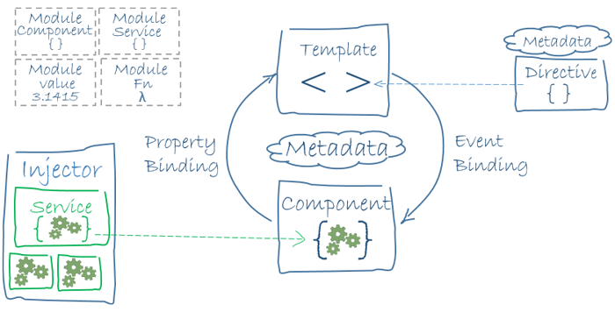
Overview

